Slide 1
React Training Course
Fundamentals of Component based development and advanced concepts

Slide 2
Topics
Clone: https://github.com/flanamacca/react-learning-kit Run: DB_TYPE=“NONE” npm run dev (nix machines)
On windows – need to install nodemon, cross-env globally and then run the npm run dev command independently
Part 1 – Fundamentals
Component Fundamentals – What is the purpose of a component driven system
Component Lifecycle – crumbs of broken dreams
Dom Manipulation and management of Dom Nodes – React, the Shadow Dom and You
Higher Order Components – The candy wrappers of React
Loading and Managing Data in Components– Ensuring your components behave well with data
Part 2 – Structuring an Application
Webpack bundling and splitting - When to split, how to split and how to monitor
Routing in a Single Page Application
Application State Management (Redux) – What Why How of Dispatching, Reducing and Storing
Server Side Rendering / Isomorphic Applications – Working in a server side world
Automated Testing and development with Jest, Storybook and Redux
Source:

Slide 3
Component Fundamentals – Things to know
React is all about discrete building blocks, or components. All components small or big should be reusable, even across different projects.
Uses JSX to combine HTML and Javascript, which is then transpiled into readable ES5 forms for browsers
All React element attributes are in camelCase rather than lower case (to allow React’s own event handler to manage performance)
Properties are immutable. Properties represent how your component was initialized and should never be modified.
State represents how your app changes over time and is expected to change (triggering re-render)
The React Shadow Dom tracks previous renders vs current renders to determine if the output has changed (and then compute these changes into Dom operations)

Slide 4
Component Fundamentals – What should I think about
Should I even make it a component?
- Wrapping anything in React adds additional load and code to running it. Wrapping HTML element is often overkill – think about what component lifecycle and properties you want and need
Does my component require data to be loaded? Is this data shared between multiple components?
- Passing properties between components (especially parent to child)
What is the minimum amount of properties my component needs to function
- Passing large objects down the tree stack adds a lot of overhead. This can come in the form of type requirements, extra processing and unnecessary complexity. A component should ONLY deal with the data it needs

Slide 5
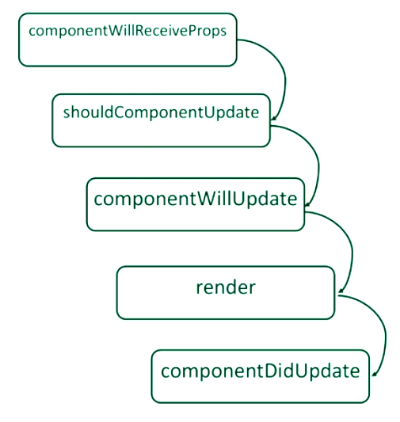
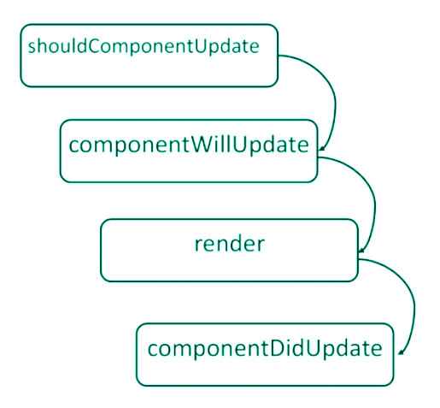
Component Lifecycle Management
componentWillMount() {
// Triggered before any rendering takes place – good time to initialize data loading. (NOTE – This function is called when Server Side Rendering)
}
componentDidMount() {
// Called once the component has completed rendering and the DOM is available here
}
componentWillUnmount() {
// Cleanup function – Destroy listeners, refs, objects in memory etc
}

Slide 6
Component Lifecycle Management - What When Where - HOW
Components will re-render whenever the properties passed to them changes, or the internal state of a component is modified.
If either the state object or the passed-in props are changed, React has an important decision to do. Should the component be updated in the DOM? This is why it invokes another important lifecycle method here, shouldComponentUpdate. This method is an actual question, so if you need to customize or optimize the render process on your own, you have to answer that question by returning either true or false.
If there is no shouldComponentUpdate specified, React runs it’s own “attempt” at this.
To determine the changed output, React invokes componentWillUpdate to determine a true/false value.
If the rendered output is identical, no changes are pushed to the Dom. If there is a difference, React uses it’s Shadow Dom to modify on the browser.
What an update does occur, React will invoke componentDidUpdate.
** Question – what is the different between a shallow compare and a deep compare? Which does React use by default? Why does this matter?

Slide 7
Components – Statefull or Stateless?
“Stateless Components are significantly faster than Statefull Components to mount/unmount and render” - Myth
Also considered a presentational component
Introduced as a design pattern to enable future optimizations.
No smart logic – if any data changes the Stateless Component will re-render.
PureComponent (React 15.3) provides a shallow equal comparison on props to resolve differences and control updates
So should I use stateless components where possible? YES
- Easier to read
- Easier to write
- Easier to manage
- Encourages reuse
- Plenty of performance improvements to come
Optimization: Call your Stateless Components as functions instead of React Components to have them run as dumb functions without any React overhead.
{Component({param: ‘value’})} vs <Component param=‘value’ />

Slide 8
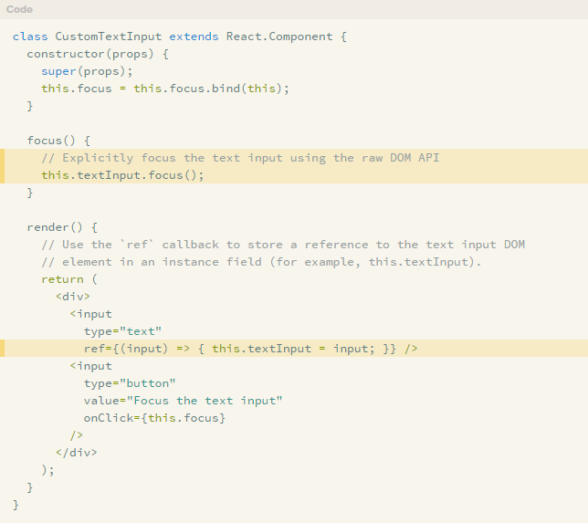
Dom Manipulation
Refs are used to interact with the Dom in React
When you specify a Dom element, you call the “ref” property on the element and provide a function. The function receives a reference to the Dom element
Use cases:
Forms (Getting the value of a field)
Changing the current browser interaction points (scroll to, field focus)
Third party UI libraries (such as jQuery*)
The ref is a pure Dom element (Low level javascript)
* jQuery is usually discouraged with React applications – but is used for things like Bootstrap (ReactStrap is a good example of managing this for you)

Slide 9
Higher Order Functions (HOCs)
A way of extending React Components to provide reusability, extensibility and control
What can we achieve with a HOC?
- Code re-use, logic and bootstrap abstraction
- Modify and hijack the rendering of components
- State abstraction and manipulation
- Property Manipulation
Some popular examples of HOC include
- Redux (connect), which wraps your component with Redux listeners and passes back changes in state as properties
- Redux Form – adds redux listeners and component watchers, to track your fields

Slide 10
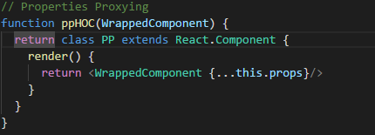
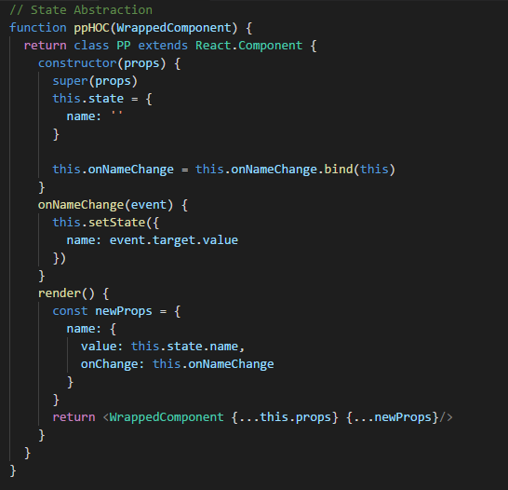
Higher Order Functions (HOCs)
Use Props Proxying
- Can manipulate the properties passed
- Access instance via refs and scope
- Abstract state away from the component
- Wrap the component with other elements or components
Use Inheritance Inversion
- Extends the wrapped component
- Access the wrapper component functions, properties and state from within the child component
- Hijack the rendered output (change props and modify the outputted component properties and element tree)

Slide 11
Data Management – Loading and Managing Data in components
Props are for data that is passed to your component from elsewhere, state is for data that is specific to your component.
Questions you should ask when loading Component data:
How many other components will need access to this data?
Ensure there is a single source of truth for data
Consider “Lifting State Up” – the process of managing data at the closest ancestor to the components that need it
Do I need to access data from an external resource (API) ?
If so, how do I track if the request has been made? Completed? Failed? Errors?
There are two key lifecycle methods that are recommended to initiate lifecycle requests – componentDidMount and componentDidUpdate(). This is because they are aware of properties being changed (props and state)

Slide 12
Component Lifecycle Demonstration
Switching to Agoda React Learning Kit
- Select Component Lifecycle from the front page
- Watch the way the state is being modified and how it impacts on the amount of steps and redraws the component is doing (in the browser console)
Files:
- app/containers/ComponentLifecycle.jsx
- app/components/LifecycleDemoComponent.jsx
TASKS: 10 minutes
- Put a notification on the screen to let us know that the same name has been picked twice in a row.
- Count how many times each name is displayed and display a table listing the results

Slide 13
Higher Order Component Demonstration – Form Management
Switching to Agoda React Learning Kit
- Select Higher Order Component from the front page
- The form wraps the components that render each of the fields and determines
Files:
- app/containers/HOCForm.jsx
- app/components/Form/Field.jsx
- app/components/Form/Input.jsx
TASKS: 20 minutes
- Add two new field types - textarea and select field
- Add error handling to the form (required fields, is numeric) that will add bootstrap error classes (‘has-danger’) to the ‘form-group’ container div
- Add form submission that ensures that there is no errors in the form and outputs the contents of the form to the console. Submit the form to

Slide 14
Data Management - Demonstration
Switching to Agoda React Learning Kit
- Select Data Management from the front page
- Loads 105 records from a local API
Files:
- app/containers/DataManagement.jsx
Questions:
- What is the problem with how I am loading in my data?
- How would you look to improve this going forward?
TASKS: 20 minutes
- Paginate the list of records that are returned from the server (10 per page)
- Show the current page in the search results
- Apply some filtering to the results so that when the user types, the results reflect the filter

Slide 15
Q & A
Thank you !

